Slide 1

REAL ESTATE PRICE PREDICTOR
Antonio Aguilar, Khemero Lee, Nipune Perera, Paulina Filippidis, Purvi Doshi
Notes:
Removing Suburbs that where 10 or less in the sales records
Removing land size less than 50 square metres
After cleaning the data we went from around 320,000 to 6000 sales records
Violin Plot

Slide 2



Our house price predictor makes use of machine learning techniques.
Notes:
We have used historical sales data to build a house price predictor based on machine learning.

Slide 3

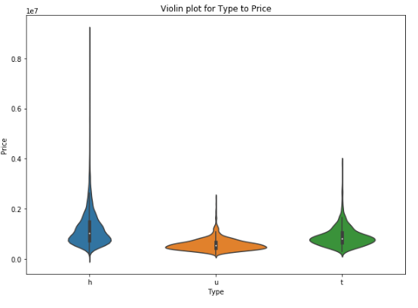
Understanding and cleaning our data
Business as usual:
Performing joins, dropping nulls, columns and removing the many outliers!
Notes:
Combining suburbs that had less than 10 together, (a dimensionality reduction technique)
Removing anomalies such as land size less than 50 square metres
Feature engineering such as price per square meter.
After cleaning the data the records were reduced significantly in number, which in turn helped us with the fit
Violin Plot

Slide 4
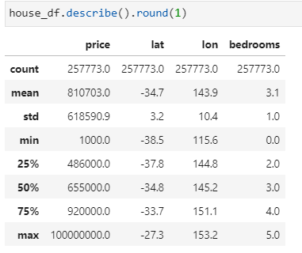
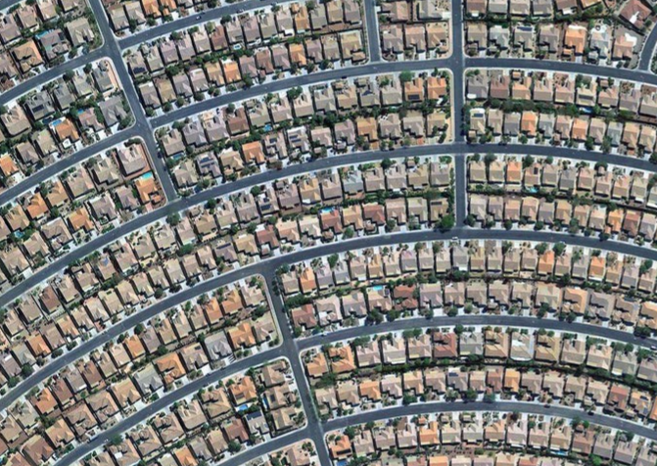
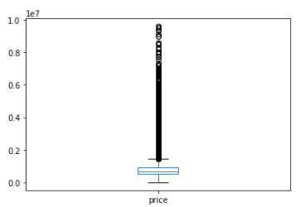
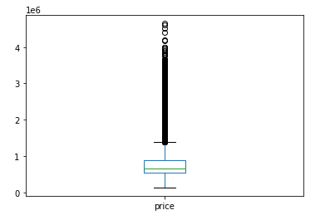
Outlier Analysis
Notes:
we wanted to remove the outliers to show a more normal distribution to be able to conduct our analysis.
If we don't remove the outliers, then it will skew the whole data set which in turn increases our error/ ability to make accurate predictions
Before and after clean box plot
The maximum house price was reduced significantly after removing outliers
Other sanity checks included:
Land sizes which were too small to live in e.g. 50sqm land size.
Building sizes which were greater than the land size
Price Outliers in bedroom Per sqm values (3 bedrooms in 50 square metres)
There were still many outliers present!

Slide 5

Additional techniques to clean data..
Outlier removal techniques we would’ve liked to use:
# Isolation Forest
# EllipticEnvelope class
# LocalOutlierFactor()
# One-Class SVM
# Light GBM
https://machinelearningmastery.com/model-based-outlier-detection-and-removal-in-python/
Notes:
There were other techniques that we could have used to remove outliers.
If we had more time, we would have further investigated the listed techniques
Richards recommended Light GBM
Light Gradient Boosting Model is based on decision trees to increase the model efficiency whilst reducing memory usage.

Slide 6



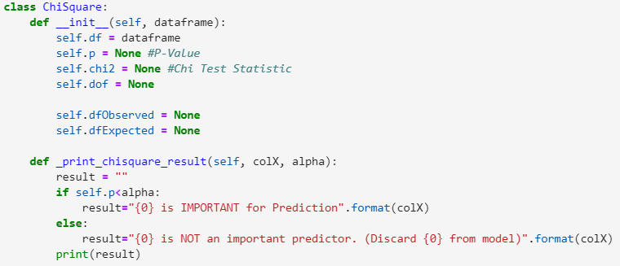
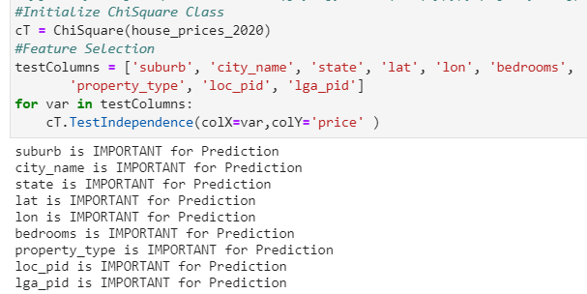
Features

Slide 7

Model evaluation
Notes:
Discuss the techniques you used to evaluate the model performance.
Scikit library - mainly for regression analysis
We used estimators root_mean_squared_error (the standard deviation of the errors in the dataset),
Mean_absolute_error - The average magnitude of the errors in a set of forecasts. It measures accuracy for continuous variables.
R-Square Value - measures the strength of the relationship between the model and the dependent variable
Chi squared showed us which features are more important
Cross_val_score - avoids overfitting

Slide 8

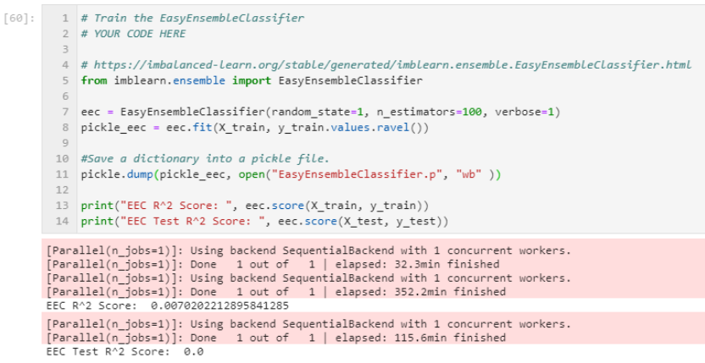
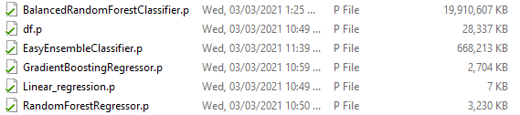
Models used
Linear regression
Balanced Random Forest
Random Forest Regressor
Gradient Boosting Regressor
Easy Ensemble Classifier
Decision Tree Regressor

Slide 9
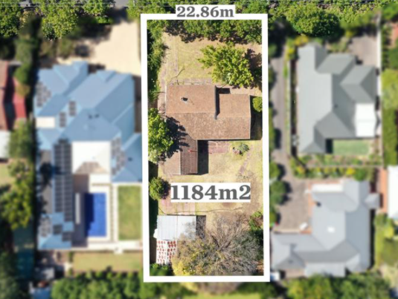
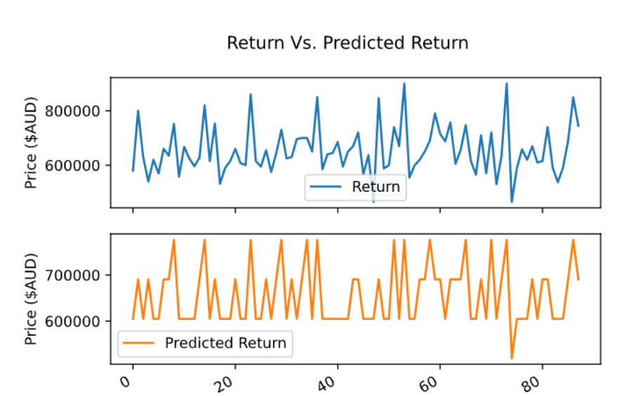

Linear regression

Slide 10
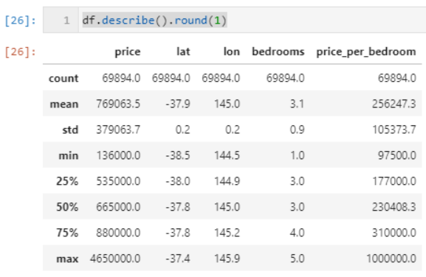
Predictive model scores
Model | R^2 Score / Test | Root Mean Squared Error: | Mean Absolute Error: | Cross Validation Score (cv=5)
Linear Regression | 0.7986 / 0.7972 | 169,703 | 114,352 | Not similar
Random Forest Regressor | 0.3368 / 0.3231 | 310,035 | 221,423 | Similar (0.297 > 0.334)
Balanced Random Forest
Gradient Boosting Regressor | 0.876 / 0.863 | 139,239 | 91,957 | Similar (0.824 > 0.845)
Easy Ensemble Classifier | 0.007 / 0.0 | 403410 | 262154 | Similar* *(0.0 > 0.0)
Notes:
Paulina to hand over to Purvi Khemero - I’ll fill in EEC: RMSE/MAE/CVS when I wake up, hopefully it's done.

Slide 11



Sentiment Analysis
Notes:
Was the model sufficient for the predictive task? If not, why not? What inferences or general conclusions can you draw from your model performance?

Slide 12
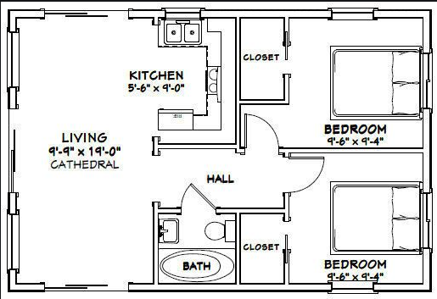

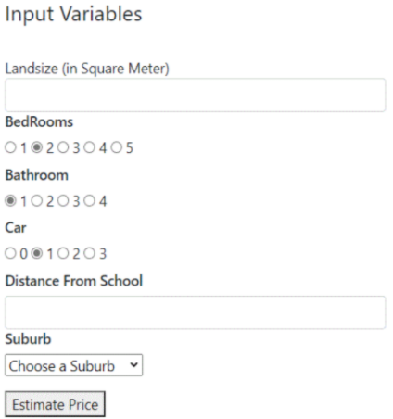
Predictive Calculator in Flask
Notes:
Random Forest Regressor

Slide 13



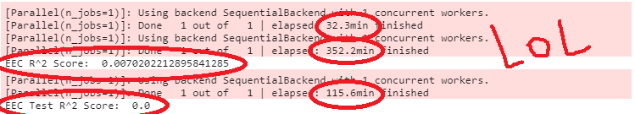


On reflection
Notes:
Discuss any problems that arose with preparing the data or training the model that you didn't anticipate.
Data size is very large (320,000 sales records) which requires a beefy system to run.
The time to run the code can take hours, even overnight e.g Easy Ensemble Classifier (EEC) took 8+ hrs to fit.
We did use pickle to save outputs, though the file sizes got very large (too big for githubs 100mb limit)
AWS didn’t really help. Still got memory errors with their processor.
We attempted to graph via pyviz but we were unsuccessful as we kept getting being asked to install unfamiliar programs. So we then decided to go with the Flask model (check this please -Khemero)
Data quality issues, there are so many outliers still remaining in our dataset.
It is worth mentioning that due to the large range in the data, the minimum price square metre was $41 and the max was $20,476. There was lots of outliers

